Slide 1
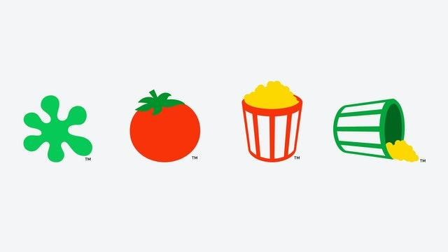
Not So Rotten Tomatoes - Scraping and Ranking RottenTomatoes
Web application url: https://not-so-rotten-tomatoes.herokuapp.com/
CS410 - Text Information Systems Fall 2021
Team Name: Not So Rotten Tomatoes
Team Members: muneshb2, puri6, jrw7
Theme: Intelligent Browsing

Slide 2
BACKGROUND
User experience is all about how browsing a web page becomes valuable and meaningful for a user.
General web search cannot accommodate all of the users’ interests when it comes to specific topics without implicit assumptions.
Results from Rotten Tomatoes allows a user to rank results by User Reviews, Critic Reviews, Genres, Audience Score
There are predefined ratings and ranking for movies on Rotten Tomatoes but there is no way to effectively search and rank movies matching the user query/interest.

Slide 3
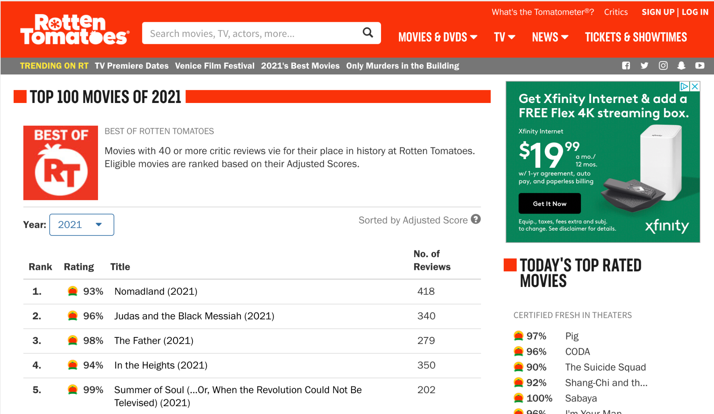
OBJECTIVE:
Try to improve the user experience of browsing the content according to user’s interest on Rotten Tomatoes
Provide an intelligent way to browse content within the Top 100 movies of 2021 on RottenTomatoes, filtered and sorted based on the user query.
Url for scraping data: https://www.rottentomatoes.com/top/bestofrt/?year=2021

Slide 4
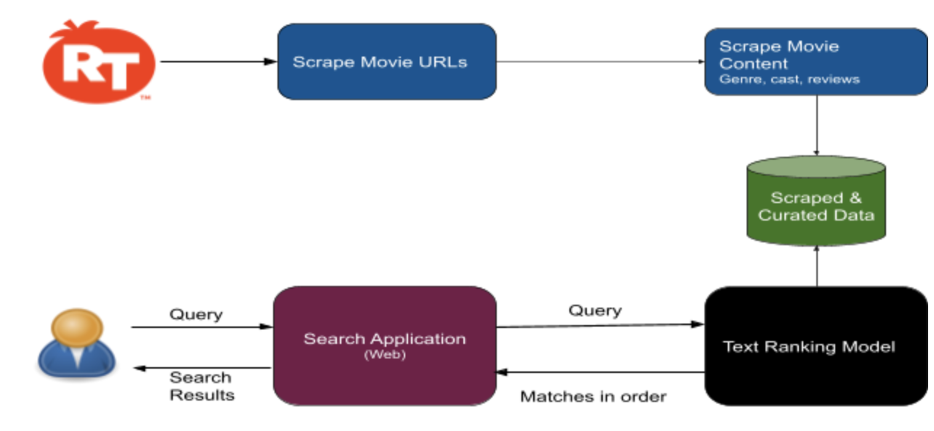
OVERVIEW
Offline
Online
Notes:
Scrape the movie URLs for the Top 100 movies of 2021.
Scrape the movie content like genre, cast, media from the 100 movie URLs scraped.
Create a ranking algorithm model to generate accurate and relevant results according to the input query.
Perform Relevance Testing and Evaluation by calculating Average Precision for each sample query, Mean Average Precision for all the sample queries and NDCG@10.
Create a web application that takes the user query and display ranked results using the ranking algorithm model.

Slide 5
SOFTWARE PREREQUISITES:
Python - The primary programming language to design the algorithm and to use its relevant libraries for assistance with scraping the web pages, text processing and modelling tasks.
The Python packages used:
Metapy
Beautiful Soup
Pytoml
Scipy
Selenium
Flask, HTML, CSS - design the web application
Heroku - Deploy the web application publicly
Gunicorn "Green Unicorn" -Python Web Server Gateway Interface HTTP server.

Slide 6
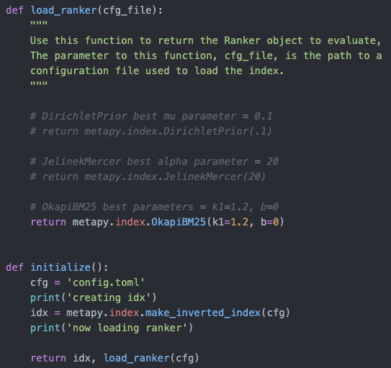
Ranking Model
Through the search_rank.py python program, users can apply a ranking algorithm in the load_ranker function to generate accurate and relevant results based on the the input query and the scraped content of each web page such as the movie title, rating, genre, synopsis, cast, and critic reviews.

Slide 7
We evaluated 3 ranking algorithms:
BM25
Jelinek-Mercer
Dirichlet Prior
We evaluated the model using mean average precision and NDCG@10 based on our tests using sample queries and explicit feedback. BM25 is in our model since we found it to have the best results after tuning for the optimal parameters for each algorithm
Algorithm | Mean Avg. Precision | NDCG@10
BM25 (k1=1.2, b=0) | 0.6741369048 | 0.8299627915
Jelinek-Mercer (Alpha = 20) | 0.6113575708 | 0.7800326674
Dirichlet Prior (mu = 0.1) | 0.6028754279 | 0.7756776975

Slide 8
DEPLOYMENT
Run the below commands in console
Clone the github repository:
$ git clone https://github.com/muneshb/CourseProject.git
Change the directory to the source folder inside the Project to run the rest of the commands.
Install all the required packages:
$ sh install.sh
Start the web server locally :
$ sh run.sh

Slide 9
(Optional steps)
Scrape the latest documents and information from source url:
$ sh scrape.sh
This step prints the Mean Average Precision and nDCG values based on the queries file
$ python search_rank.py config.toml
Alternately, the application can be accessed directly by using the web url:
https://not-so-rotten-tomatoes.herokuapp.com/

Slide 10
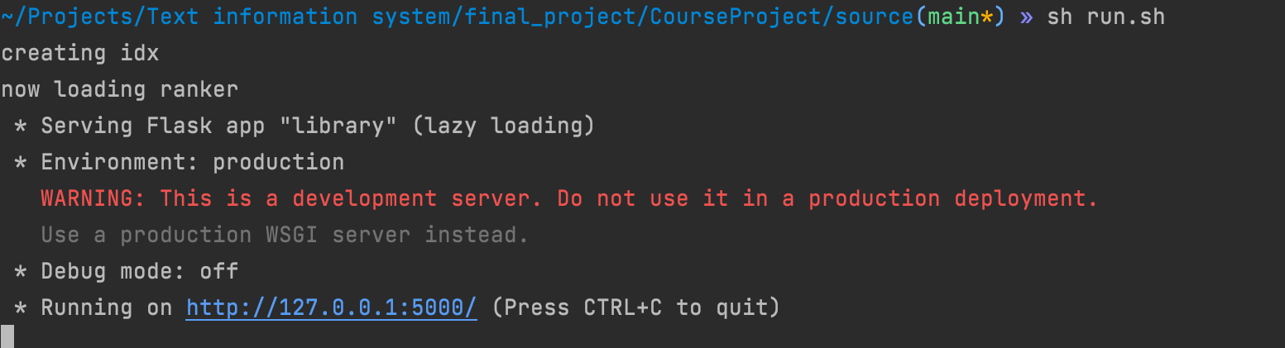
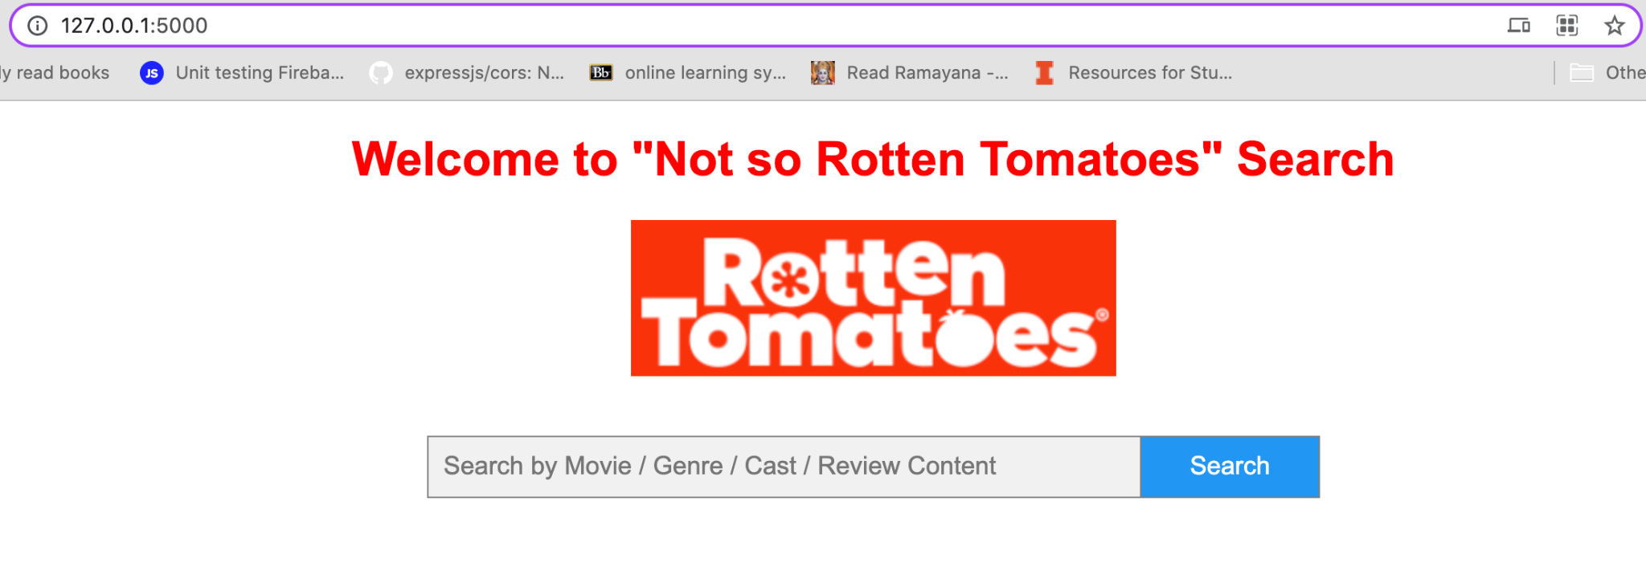
SOFTWARE USAGE
After starting the server, you will see the below message with the URL
Open the web page at : http://127.0.0.1:5000/

Slide 11
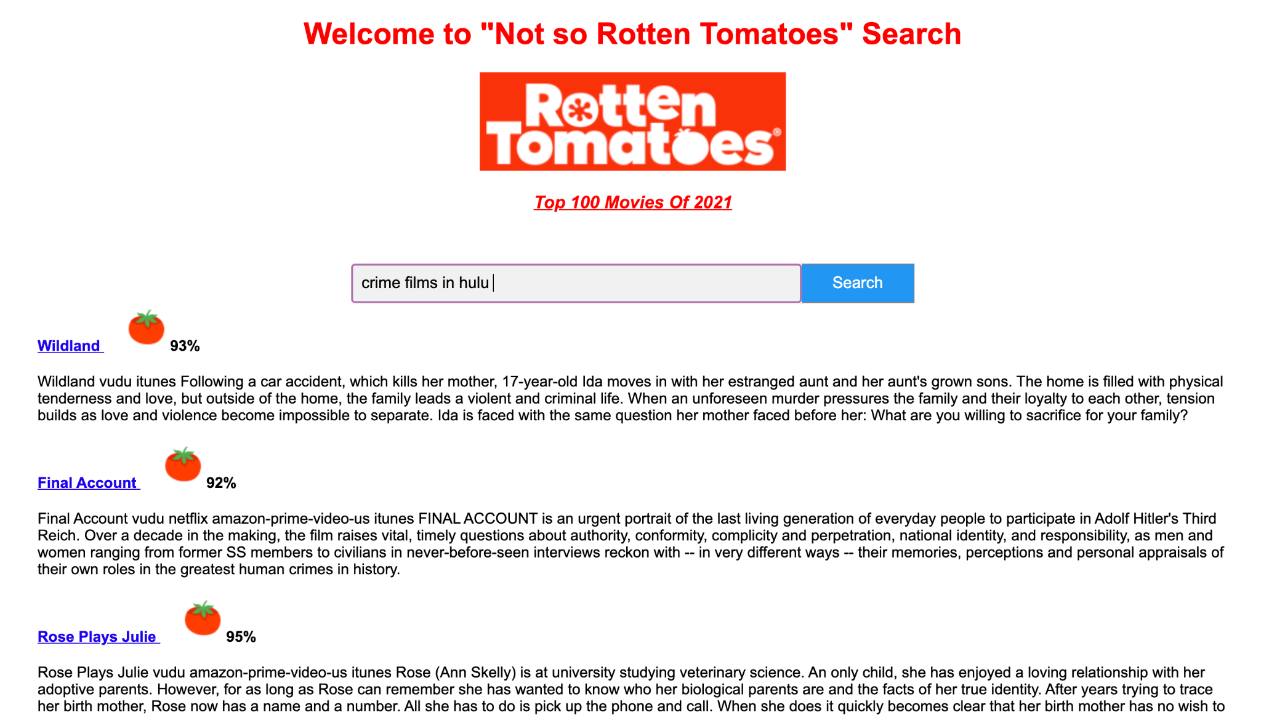
SOFTWARE USAGE
Enter search query for the movie cast, genre, reviews, where to watch and view your results

Slide 12
Source url:
https://www.rottentomatoes.com/top/bestofrt/?year=2021
Run the application locally:
http://127.0.0.1:5000/
Run the application on web:
https://not-so-rotten-tomatoes.herokuapp.com/
GitHub Repository:
https://github.com/muneshb/CourseProject

Slide 13
FURTHER IMPROVEMENTS
Generic System - with minimal changes, any other web platform can integrate this application to filter and rank any information like it has been implemented here for “Top movies in 2021 on RottenTomatoes”.
For instance our application can be adapted to below use cases:
Best movies of all times on Rotten tomatoes- https://www.rottentomatoes.com/top/bestofrt/
Barnes & Noble's Best Books of 2021
https://www.barnesandnoble.com/b/books/best-books-of-the-year-2021/barnes-nobles-best-books-of-2021/_/N-29Z8q8Z2w2g
With more data, the ranking system can be improved to provide better results with improved precision with proper tuning.
Users can further use Google or information websites like https://www.digitaltrends.com/ to search the query and evaluate the results and the system’s accuracy.
“Not-so-RottenTomatoes”
“Not-So-<any platform>”

Slide 14
REFERENCES
Top 100 movies of 2021, Rotten Tomatoes: https://www.rottentomatoes.com/top/bestofrt/?year=2021
Zhai, C. & Massung, S. (2016). Text data management and analysis: A practical introduction to information retrieval and text mining. ACM Book Series. Morgan & Claypool Publishers.
N. J. Belkin and W. B. Croft. 1992. Information filtering and information retrieval: Two sides of the same coin? Commun. ACM 35, 12 (Dec. 1992), 29-38.
Mark Sanderson. Test collection based evaluation of information retrieval systems. Foundations and Trends in Information Retrieval 4, 4 (2010), 247-375.
Meta-ToolKit: https://meta-toolkit.org/
Metapy Search and IR evaluation Tutorial : https://github.com/meta-toolkit/metapy/blob/master/tutorials/2-search-and-ir-eval.ipynb
Implementation of the ranker functions: https://github.com/meta-toolkit/meta/tree/master/include/meta/index/ranker
How to scrape websites with Python and BeautifulSoup : https://www.freecodecamp.org/news/how-to-scrape-websites-with-python-and-beautifulsoup-5946935d93fe/
The Flask Mega Tutorial by Miguel Grinberg: https://blog.miguelgrinberg.com/post/the-flask-mega-tutorial-part-i-hello-world
Deploy app on Heroku using Git: https://devcenter.heroku.com/articles/git
Deploying Flask app on Heroku using GitHub: https://dev.to/lordofdexterity/deploying-flask-app-on-heroku-using-github-50nh

